Slide 1
Welcome to Y3!

Slide 2

Our Staff
Class teacher: Miss Read
Teaching assistant (mornings):
Mrs Barron
Additional teaching assistants in our class : Miss Moss, Mrs Bennett, Miss Martin, Miss Atkinson and Miss Bickerstaff
On Wednesday afternoons, Y3 has R.E./music/P.S.H.E. with Mrs Harrison and Miss Moss.

Slide 3
Our Timetable
Morning
G.P.S, English, reading and Maths
Assembly on Monday
Afternoon
Geography
History
Computing
PE
Science
PSHE
French
Topic Weeks:
Art and D.T. are taught as blocked weeks, usually at the end of a half term.

Slide 4
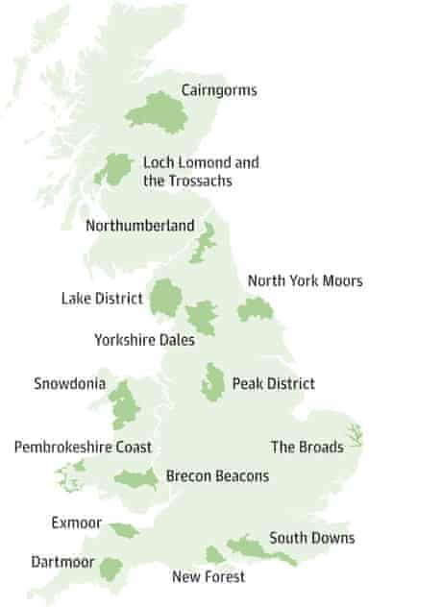
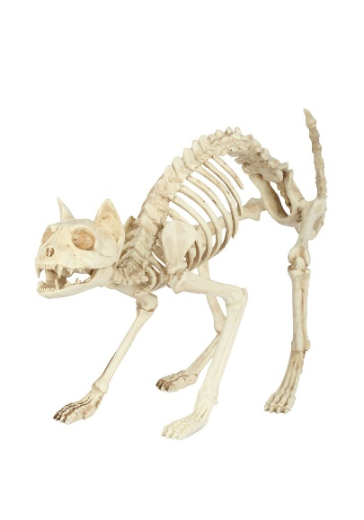

Our Topics
For the first half term, our main topics are:
Maths: place value, ordering & counting, addition & subtraction (3 digit numbers)
English: story: comedy (focus: dialogue)
Science: Skeletons & Muscles
Geography: National Parks (The Lake District)
We will have an art week on natural sculptures before half term (weather permitting).
Our future topics are on the long term plan, on the class page of the school website.

Slide 5

P.E.
It’s Tuesday and Wednesday for this first half term!
Usually our class P.E. days are Tuesdays and Thursdays.
Kit: black and white P.E. kit (trainers, white t-shirt, black jumper and shorts/ track suit trousers depending on the weather).
Earrings and watches should not be worn on P.E. days. If earrings cannot be removed, children will need to bring plasters to cover them. Plasters will not be provided.

Slide 6

Working At home
We expect that all children carry out the following each week:
Read at home and make comments in home reader at least three times a week.
Complete a writing task in their reading diary.
Complete a minimum of 20 minutes on TTRS.
Revise Year 2 and learn Year 3 and 4 spellings.
No other homework will be set unless your child has a specific area they need to work on.
Maths No Problem reviews will be sent home so children can be supported at home if needed.

Slide 7

Working at Home
Reading
Although some of the children are fluent readers by now, it is really important that they continue to read at home with an adult as often as possible (as well as independently) to build their comprehension skills and vocabulary.
The children can change their home-school reading book when they have finished it and written comments in their reading record book. This can be done on any day of the week and they are responsible for remembering!
At school, the children will have classroom library books to read independently as well as having regular guided reading sessions.
The children will also be able to visit the school library most weeks.

Slide 8
Questions to help Develop Comprehension Skills
Simple Recall Questions
Where does the story take place?
When did the story take place?
What did s/he/it look like?
Who was s/he/it?
Where did s/he/it live?
Who are the characters in the book?
Where in the book would you find…?
Questions requiring synthesis
What is your opinion? What evidence do you have to support your view?
Using all the evidence available, can you tell me what you feel about…?
Given what you know about … what do you think?
How would the views put across in this text affect your views on…?
What would this character think about…? (Possibly a present day issue)
Analytical Questions
What makes you think that?
What words give you that impression?
How do you feel about…?
Can you explain why …?
I wonder what the writer intended?
I wonder why the writer decided to…?
What do these words mean and why do you think the author chose them?
Has the author used adjectives to make this character funny?
Why did the author choose this setting?
Simple comprehension questions
What do you think is happening here?
What happened in the story?
What might this mean?
Through whose eyes is the story told?
Which part of the story best describes the setting?
What words and/or phrases do this?
What part of the story do you like best?
Evaluation questions
What makes this a successful story?
What opinion do you have to justify your opinion?
Does it work?
Could it be better? How?
Is it as good as…?
How is it similar/different to…?
Which is better and why?
Application Questions
Can you think of another story which has a similar theme;
eg. good over evil; weak over strong; wise over foolish?
Do you know of another story which deals with the same issues;
eg. social; moral; cultural?
Which other author handles time in this way;
eg. flashbacks; dreams?
Which stories have openings like this?

Slide 9

Homework: Spelling
Please practise and reinforce the correct spelling of high frequency words as well as homophones (e.g. there/ their/ they’re), which are often a sticking point.
The children will be given their spelling record to take home when it is updated each term. The words they can spell will be highlighted.
The Y1/2 and Y3/4 spelling lists and a grid of activities to make spelling more fun are on the following pages. The spellings are also available on the school website.
On our class page under “links”, there is a list of some useful and fun online games.

Slide 10
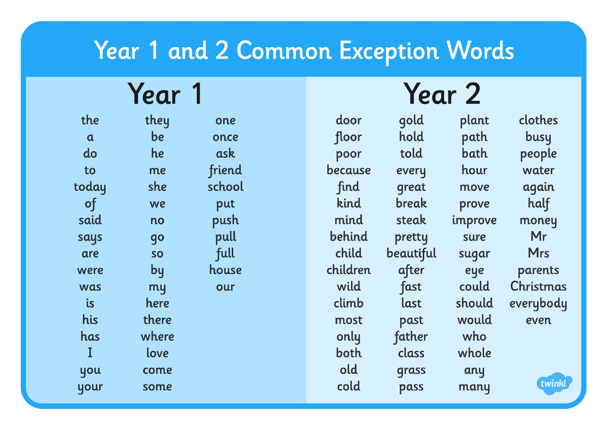

Slide 11
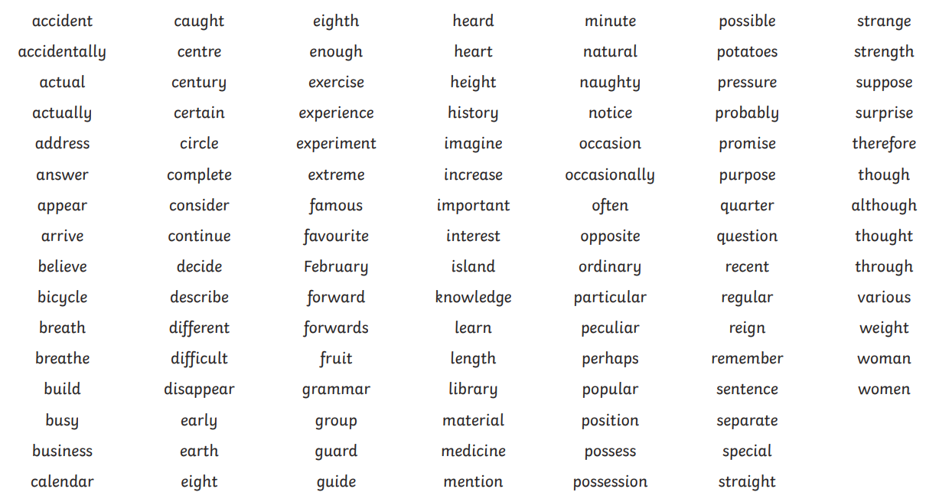
Years 3 and 4 Statutory Spellings

Slide 12

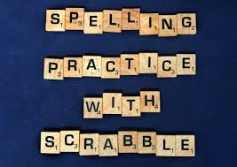



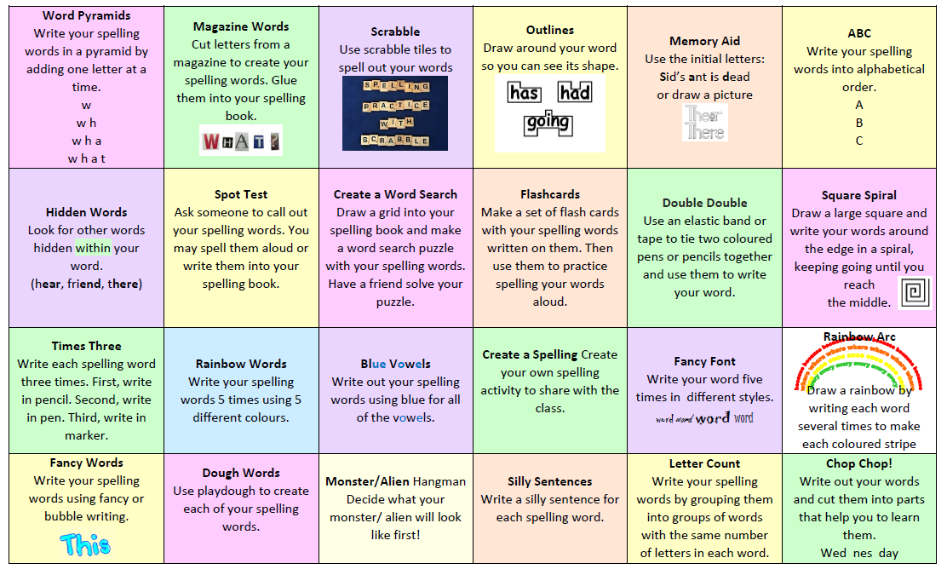


Slide 13


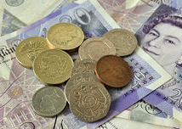
Working at Home: Maths
Please practise mental maths skills, especially times tables, as a lack of this knowledge can become a barrier to accessing Y3 maths work.
Things to practise regularly:
number bonds (10= 2+8 = 6+4 etc. 100 = 20+80 = 60 +40 etc. 100 = 28 + 72, etc.
times tables (TTRS) To have achieved Y2 standard, children should already have fast recall of 2, 5 and 10 times tables and be able to say their 3s and 4s. By the end of the year, we aim for them to have fast recall of the 2-5, 8 and 10 times tables.
mental addition and subtraction of 2-digit numbers.
using money (all coins & notes) and working out change.
telling the time to the minute (both analogue & digital) and working out time intervals (e.g. What time will it be in an hour and a quarter? What time was it 40 minutes ago? How long has it been since…? How long is it until bedtime?)
Can they work out what time it is just by looking at the hour hand?
Any practical application of maths (measuring, baking, etc.)

Slide 14
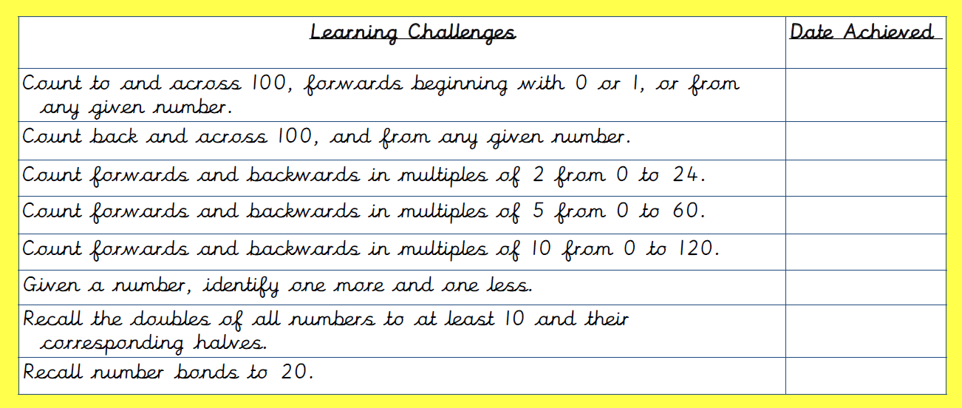
Year 1 mental maths skills:

Slide 15
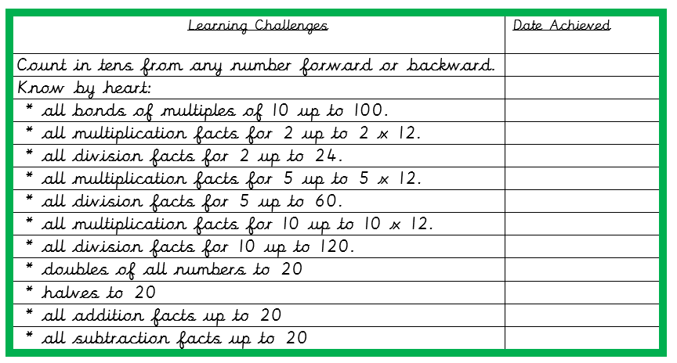
Year 2 mental maths skills:

Slide 16
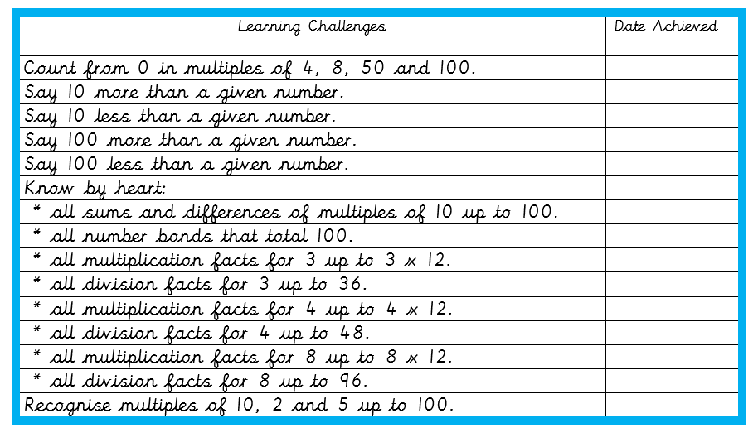
Year 3 mental maths skills:

Slide 17
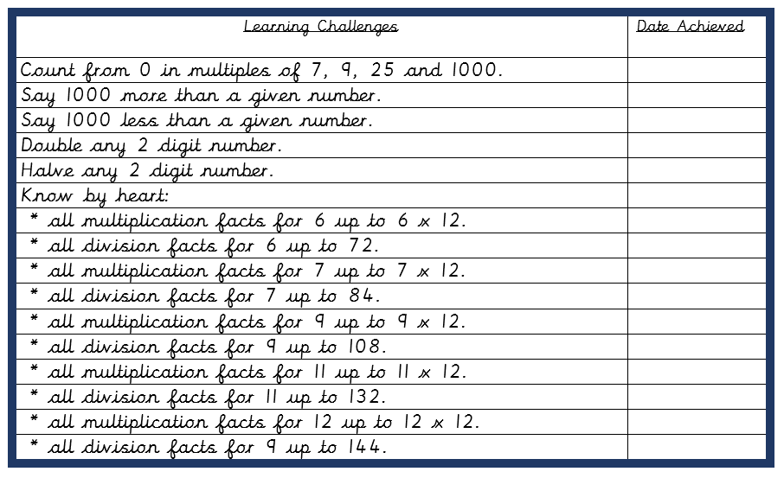
Year 4 mental maths skills

Slide 18


Equipment
Bags are kept on the children’s pegs, so either reading packets or small back packs are ideal. There is no room for large bags so please keep these at home.
The children should not bring any equipment or things to show into school unless they have been asked to. We do not have regular ‘Show and Tell’ but if the children have something connected with our topics they would like to share or if they have achieved or made something special at home, a photograph can be uploaded to Dojo so that they can show the class.
Please ensure that all items of clothing and water bottles are named so that lost property can easily be retrieved. The children are responsible for their own property and have access to the lost property box at playtimes.

Slide 19


Communication
Please use the Dojo messaging facility. We will reply as soon as possible.
Please understand that messages sent during the day might not be read until after school as staff are teaching. If a message is urgent (e.g. changes to who is picking children up after school), it is better to contact the office.
Use the school’s website http://www.manor-road.lancsngfl.ac.uk/ to keep an eye on dates and the
newsletter is updated weekly, providing information and key dates to be aware of.
Please also use the website to view our class page.

Slide 20
General Information…
Please look out for the Home/ school agreements and Acceptable Use Agreements which will be sent home via ParentMail.
Children should only bring a reading book bag or other SMALL bag, as larger bags do not fit on their pegs.
Children can bring in a healthy snack with minimum packaging for break time and water in a named water bottle.
Please remember to follow the voluntary one-way system on Manor Road. School car parks should not be used at drop off and pick up times unless you have a Blue Badge or a pass from school
Please use the sports email address sport@manorroad.lancs.sch.uk to contact school regarding any sports clubs/ matches etc.
School lunches: details of how to pay are available on the website under the school lunch tab. If payments are more than two weeks in arrears, children will not be given a school lunch.

