Slide 1

Welcome to Year 6 ☺
Class of 2027

Slide 2
Year 6 Staff
Massive congratulations to Mr Atkinson who finished his teacher training earlier this year and has joined the Manor Road teaching team.
Class teachers: Miss Otto and Mr Atkinson
Teaching Assistants: Mr Atkinson, Miss Unsworth, Miss Moss and Mrs Roberts.
Miss Otto will be in class as class teacher Monday-Wednesday and Mr Atkinson will be class teacher Thursday-Friday.

Slide 3
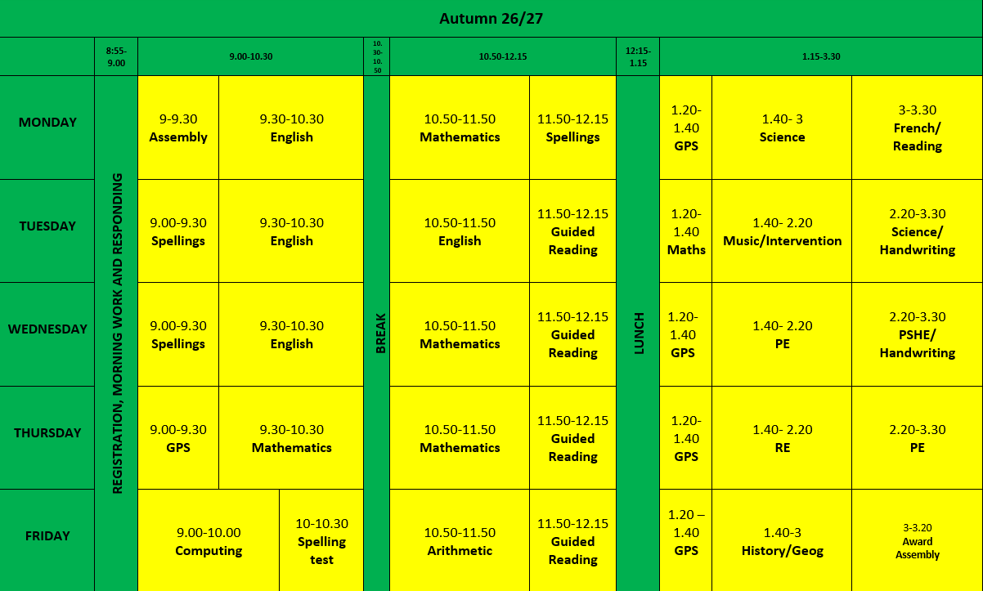
Class Timetable

Slide 4
Homework
Children in Year 6 will bring homework home every week. To prepare for the statutory tests at the end of the year, children will be provided with CGP booklets which cover all aspects of the curriculum which will make up the end of year tests. Booklets given will alternate between Maths, Reading and GPS.
Children will again be encouraged to go on TTRS for 20 minutes a week, with weekly winners to be announced in our Friday assembly.
Children will also bring home lists of spellings to practise at home on a weekly basis.
Homework will be given out on a Friday and
will be due back the following Wednesday.

Slide 5
Reading Records
All children have a reading record and reading book which is linked to their reading ability. Reading books are changed by the children in Year 6. Books should only be changed once the book has been read and detailed comments have been made.
Parent comments are not required in books in Year 6. However, if you would like to make a comment at any point, please feel free.
Children are expected to write three detailed comments about their reading on a weekly basis and reading records will be checked weekly by Miss Unsworth. Children will also be expected to complete the creative writing activity each week.

Slide 6
PE
PE lessons will take place on a Wednesday afternoon and a Thursday afternoon – please ensure children come to school in full PE kit on these days.
PE kit is black shorts, white t-shirts and black hoodie/zipped jacket.
Outside kit can be worn when it is colder weather – plain black joggers.
Please ensure all kit is labelled as we have a huge amount of lost property every half term.

Slide 7
Behaviour
At Manor Road, children follow three simple expectations:
Ready Respectful Safe
The school expectations are discussed with children regularly in class, and are displayed in every classroom and across the school.
In class, we have a weekly focus linked to our school values and children demonstrating that behaviour focus will have their name added to the recognition board. Each week, there is a Headteacher’s Award which is celebrated in the Friday assembly.

Slide 8
Home School Agreement
At Manor Road, we value our partnership with you as parents; one element of this is our Home-School Agreement.
All schools have these and we revisit and distribute ours each year. The Home-School Agreement will be sent out as a form on Parent Mail.
Please discuss it with children, then complete the agreement section before submitting the form. This form should be submitted online. (See Mrs Conway)

Slide 9

Newsletters and dates for your diary
School’s website http://www.manor-road.lancsngfl.ac.uk/ Keep an eye on dates and
Our newsletter is updated weekly and it provides you with lots of information and key dates to be aware of.
Please also use the website to view our class page.

Slide 10
Mobile Phones
We understand that by Year 6, more children will be bringing phones to school.
If your child does want to bring a phone to school, you will need to complete the form on ParentMail. If you have already completed one, you will not need to do this again.
All phones should be switched off when children are on school grounds and placed in the box to be stored in the classroom cupboard for the day. Children should not be using their phones in school at any point. Children should keep phones switched off at the end of the day until they have left the school grounds.

Slide 11
Year 6 Sats!
Year 6 Sats week will be held the week beginning Monday 10th May.
There will be a Sats meeting held closer to the time outlining the expectations of the tests and the timetable for the week.
The children will be well prepared for these tests by the time they arrive. We will be using past Sats papers in class to practise so can I please ask that you do not use these at home with your children unless they are sent home by school.
Even though these tests are a statutory requirement and we want children to do their best, they do not define your children so please don’t worry about them. Your children are all amazing and we don’t need a test to tell you that!

Slide 12
Year 6 Residential
Every year, Year 6 visit Robinwood in Wrexham for their residential trip.
This is a great opportunity for children to try out lots of different fun activities with their classmates and teachers in a more relaxed environment. The children always have a blast and we’d encourage as many children as possible to come.

Slide 13
General Notices
1. If anyone new/different is collecting from school, please inform the office either by telephoning, DOJOs or sending a note in.
2. Please can children have notes/letters/money in their hands as they come into school to ensure it goes straight to the right place.
3. Children may bring in water in water bottles but they must go home every evening.
4. Children can bring in a healthy snack for break time.
5. Lunches are chosen daily.
6. The Home School Agreement will be sent home via a ParentMail form.
7. Please remember to follow the one-way system and speed limit so we can keep everyone safe!

