Slide 1


Welcome to Reception

Slide 2

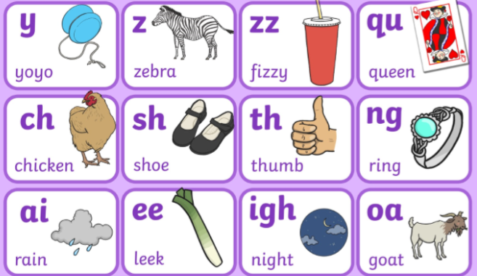

Your child will have lots of fun while learning in Reception.
Here’s how you can help…

Slide 3

Class Timetable
Morning
Phonics- groups changed frequently
English-indoor and outdoor provision
Maths- Maths No Problem, mixture of adult led and independent
Guided Reading- daily in groups, assessed frequently to meet needs
PE- (Monday and Tuesday) Children come to school in PE kits from next week
Afternoon
Continuous Provision which includes lots of fun and creative learning
RE/Computing/Music/Understanding the World/Art
Show and Tell- I will send more information when we are in groups
Spellings (Friday morning) These will start in Autumn 2 for Reception when children have completed Phase 2 sounds

Slide 4
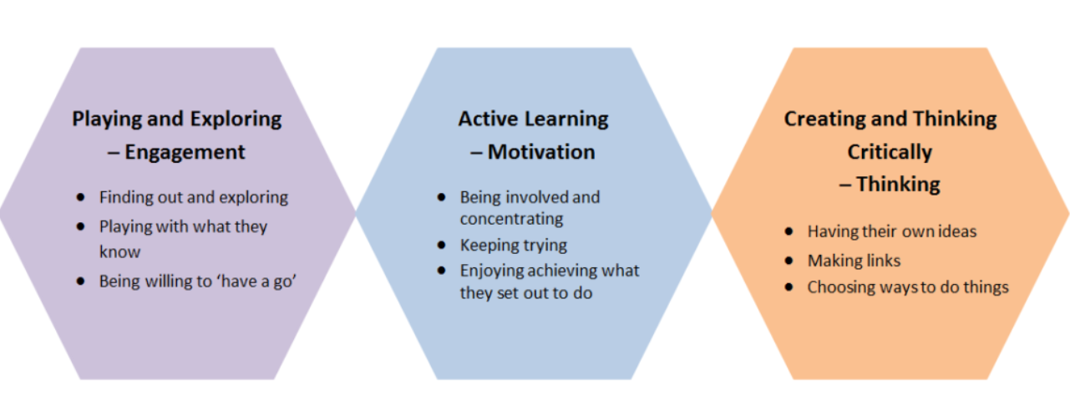
The timetable in Reception covers the 7 areas of the Foundation Stage:
Communication and Language
Personal, Social and Emotional Development
Physical Development
Literacy
Mathematics
Expressive Arts and Design
Understanding the World.

Slide 5
Maths-No Problem!
In Reception, children will be taught maths using the Maths-No problem! scheme. Incorporating the use of resources, problem solving and group work, the Primary Series is child-centred and practical.
As young as eight months old, children are developing an awareness of number names, and include these in their speech, as soon as they begin to talk. As children listen to the talk around them, they are introduced to numbers through opportunities that occur in everyday life, and experience a variety of number rhymes. This supports their growing knowledge of number names.
According to the NCETM, there are:
Six key areas of mathematical learning
Cardinality and counting- how many things numbers refer to
Comparison-comparing using more/less
Composition-knowing numbers can be made up of smaller numbers. Part/whole
Pattern-patterns in everyday life and numbers
Shape and Space-2D/3D
Measures-length, weight, volume

Slide 6

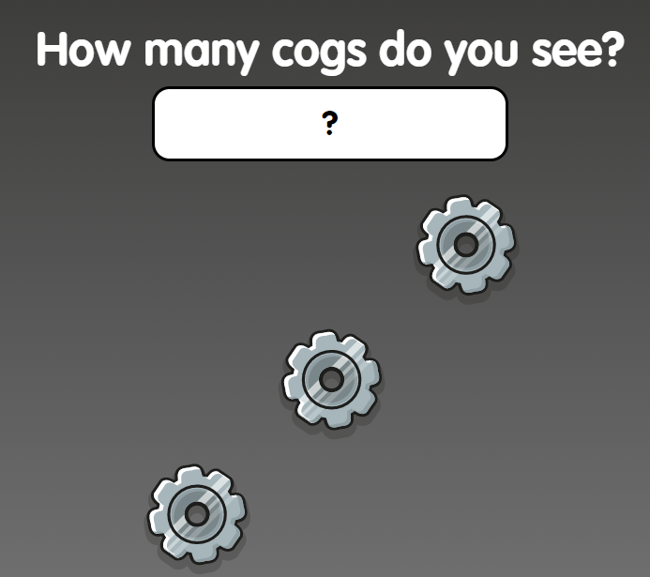
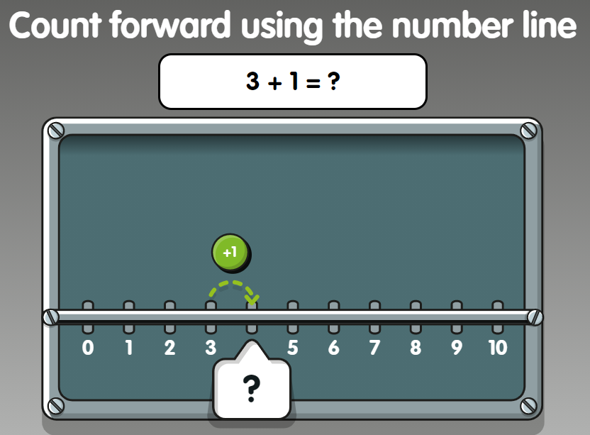
You will have a log in code in your pack.
One child per week will be chosen based on
the effort during that week on the app. This
Will be shared in Friday’s assembly.

Slide 7

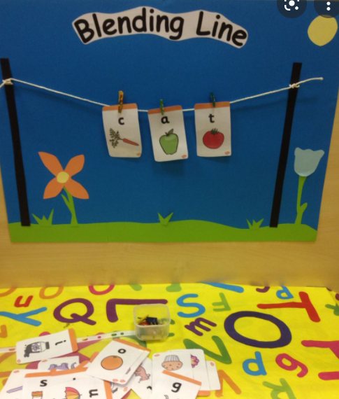
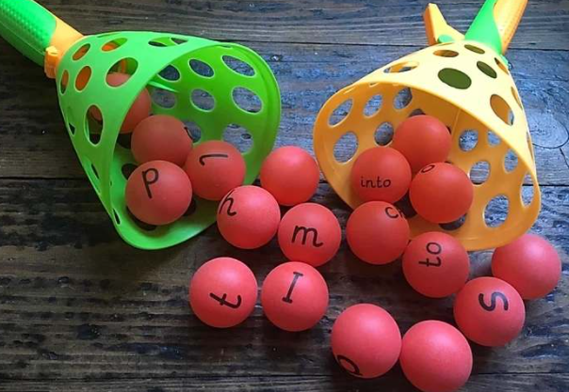
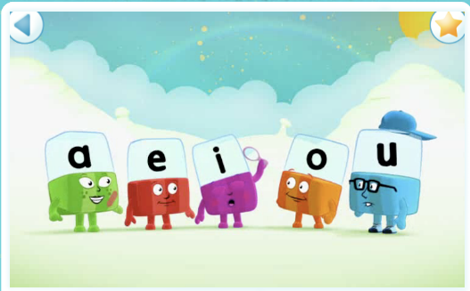
Phonics
All children will have daily phonics sessions and groups will be fluid.
Children will learn at a fast and fun pace.
Phase 2/3/4 will be taught in Reception and some children will move onto Phase 5.
Reading and writing will be taught using phonics and a mixture of high frequency words and tricky words.
Reading books will match phonic ability and will be changed frequently.
Guided Reading sessions will consolidate phonics sessions.
Phonics will be applied in all areas of learning and consolidated through play.

Slide 8

Reading Books/ Spellings
Reading books are changed provided there is a comment in the child’s book to say the book has been read and how they read/did they enjoy the book/ could they apply their phonics etc?
Children must hand their reading book in for the book to be changed. We don’t go through all bags as this would take a long time. Please encourage your child to walk into school holding their book and record in their hand in the morning if they need it changing. It can then go straight into the box. Books can be changed on a Monday and Friday if needed. Children should read their book x3 times (x3 comments) before changing to help with fluency. Children get a stamp every time they read and if they get x3 or more stamps a week, a raffle ticket goes in the pot. At the end of the half term, we pick out 5 tickets and those 5 children get to come to school on the last day of the half term in non-uniform.
Spellings sent home on a Friday and tested the following Friday- Reception will only receive spellings once they can read several high frequency words and once they can write cvc words- usually Autumn 2/ leading up to Christmas if they are ready. ☺

Slide 9
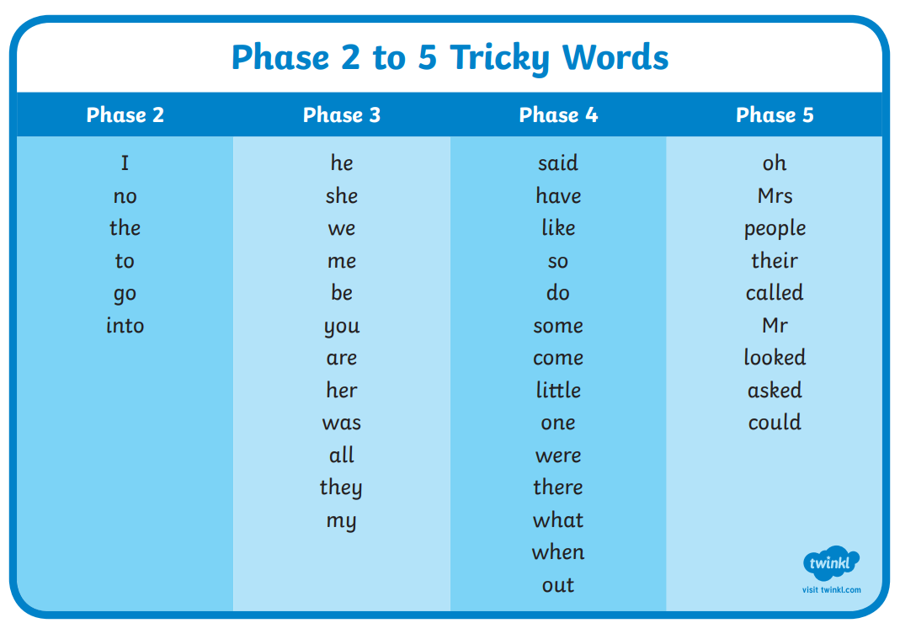

Slide 10
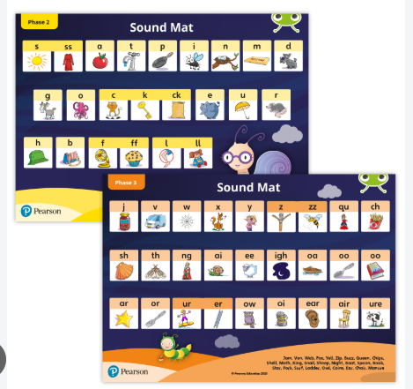

Slide 11


P.E
Reception PE days: Monday and Tuesday
Please send children into school in their PE kit.
PE Kit
Indoor and Outdoor- either is fine but if we are doing gymnastics or dance inside I will let you know on dojos.
Black joggers/tracksuit top
White PE T-Shirt
Black PE shorts
Trainers
Please label all kit- even school shoes!!
In Spring we will be asking children to bring their kit in a bag and we will start getting them changed to work on independence!

Slide 12
Snack Time
Snack time will be at 10:10am (ish) every day.
All children will receive fruit in the afternoon.
Children will be offered water or milk with their lunch.
Children who have paid into the snack scheme (£30 for the year) will have snack daily. The snacks will cater for allergies as well as ensuring children have a mixture of healthy, filling and sometimes a little treat!

Slide 13
Key Person
The EYFS statutory framework states:
The key person must help ensure that every child's learning and care is tailored to meet their individual needs. The key person must seek to engage and support parents and carers in guiding their child's development at home.
Your child will either have Mrs Foulds, Mrs Mason or Miss Stanley as their Key person. We all get to know the children equally as well, however.

Slide 14
EYFS Baseline Assessment
The purpose of the reception baseline assessment is to provide an on-entry assessment of pupil attainment to be used as a starting point from which a cohort-level progress measure to the end of key stage 2 (KS2) can be created.
The assessment consists of:
* mathematics tasks * early number * early calculation (early addition/subtraction) * mathematical language o early understanding of pattern * early vocabulary * phonological awareness * early comprehension
The assessment will take place with Mrs Foulds 1:1 with each pupil over the next couple of weeks (some have already started).
We will also complete our own baseline assessments so we can tailor teaching and learning to suit all individual children and their starting points.

Slide 15
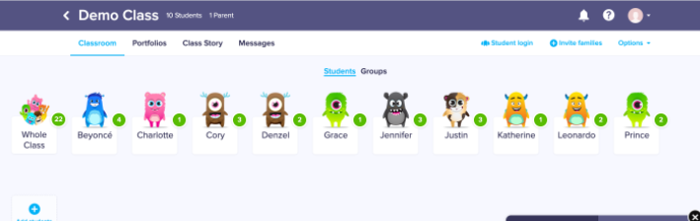
Class Dojo/Learning Journeys
All children will have a personal paper learning journey this year.
Wow moments can be sent to school from home which can be added to the book. These are in your pack. Feel free to draw your own stars/ get creative. ☺
It will be a journey of ‘wow’ moments rather than every bit of work. The children will have workbooks for English and Maths as well as photos on Class Dojo.
Messages can be sent to and from school between the hours of 8:30am and 5:00pm. Please note messages outside of these hours will be responded to the following day.
Class Dojo is great for showing you what children have been doing on the class story as well as the school story for whole school projects.

Slide 16
The Manor Road Code
READY, RESPECTFUL, SAFE
Recognition Board
Positive recognition and working as a team
Birthday celebrations
Trips to see Mrs Marshall
Good communication

Slide 17






Show and Tell Groups
Monday
Mr Grumpy
Wednesday
Mr Bump
Friday
Miss Princess
Tuesday
Miss Sunshine
Thursday
Miss Hug
Friday
Mr Tall
Children are already in groups and know which one they are in

Slide 18

Newsletters and dates for your diary
School’s website http://www.manor-road.lancsngfl.ac.uk/ Keep an eye on dates and
Newsletter which is weekly.
Gives information of any events, awards, and general school life.
The Ash webpage will be updated regularly and you can see what exciting things we get up to in class mainly on the dojo page!

Slide 19
Other Information…
If anyone new/different is collecting from school please inform the office either by telephoning or sending a note in on dojos. Passwords must be given or children won’t be handed over.
Please can children have notes/letters/money in their hands as they come into school to ensure it goes straight in the box. This also promotes independence.
Children may bring in water in water bottles but they must go home every evening and must be clearly labelled as many are the same. No juice please, just water.
Lunches are chosen.
Please can children bring in a pair of wellies to keep in school.
Forest school is weekly until the summer months when we will be doing balance bike sessions.

Slide 20
In your pack
Please keep this pack in your child’s bag with their reading book, record and spelling book(when they get one). Reading book and record
Tricky words
Wow moments form
Maths passport targets Reception
Phase 2 sounds
Numbots (MATHS) and activ learn log in codes ( Online reading platform which I will show you at the phonics meeting)
Please have reading records in bags EVERY day as we read with different children on different days and sometimes we change this.

Slide 21

How can you help your child at home?
Talk to your child about their day.
Help children with their homework and key words/ common exception words/spellings.
Read frequently with children using a range of books. Reading at home really does help children so so much!
We have a ‘can do’ approach and always encourage children to have a go!
Thank you for taking the time to read this welcome pack.
☺

