Slide 1

Welcome to Year 4

Slide 2
Year 4 Staff
Welcome to Year 4.
I am Mrs Lawrenson the Year 4 teacher. The teaching assistants in Year 4 are Mrs Bennett, Miss Barber, Miss Stanley, Miss Martin and Mr Barton.
Mr Barton teaches Year 4 on a Thursday afternoon and all day Friday.

Slide 3
Class Timetable
Morning
Assembly (Monday)
English, reading, spellings, handwriting and Maths
Afternoon
You will be taught usually two lessons in an afternoon. They may include …
Geography
History
Computing
PE
Science
PSE
French
Art
D&T
Music

Slide 4
Working at home.
Although we do not send home official homework, we do expect that all children carry out the following each week:
Read at home and make comments in home reader at least three times a week.
Carry out a minimum of 20 minutes on TTRS. ( This is checked by Mrs Foulds weekly )
Revise Year 3 and 4 spellings.
No other homework will be set unless your child has a specific area they need to work on.
I will send home Maths No Problem reviews to help support children at home if needed.

Slide 5

Maths-No Problem!
In Year 4, children will be taught maths using the 'Maths-No problem!' scheme.
MNP incorporates the use of resources, problem solving and group work.
We are currently working from the 'New Edition' books.

Slide 6
PE
PE lessons will take place on a Monday and a Friday.
Throughout the year, these slots are likely to stay the same. If they change, a Dojo message will be sent to update you beforehand.
PE kit is black shorts and white t-shirt.
Outside kit can be worn when it is colder weather.
Please ensure all kit is labelled as we have a huge amount of lost property every half term.

Slide 7
Behaviour
At Manor Road, children follow three simple expectations:
Ready Respectful Safe
The school expectations are discussed with children regularly in class, and are displayed in every classroom and across the school.
Our 'Relationship and Behaviour' policy highlights how we address negative behaviour and how we implement positive reinforcements in school effectively. These can be found on page 8 – 10 of the policy found on our website.

Slide 8
Home School Agreement
At Manor Road, we value our partnership with you as parents; one element of this is our Home-School Agreement.
All schools have these and we revisit and distribute ours each year. The Home-School Agreement will be sent out as a form on ParentMail this week.
Please discuss it with children, then complete the agreement section before submitting the form. This form should be submitted online. (See Mrs Conway)

Slide 9
Reading Books/ Spellings
Reading books are changed by the children in Year 4.
Books should only be changed once the book has been read and detailed comments have been made.
Parent comments are not required in books if Year 4. However, if you would like to make a comment at any point, please feel free.
The children will be tested regularly on their Year 3 and 4 spellings. They will be aware of their own personal spellings and should focus on these a home.

Slide 10
Multiplication Test
https://www.gov.uk/government/collections/multiplication-tables-check - Information can be found on the government website.
In Year 4, all children are expected to complete the multiplication tables check test.
The purpose of the check is to determine whether your child can fluently recall their times tables up to 12, which is essential for future success in mathematics. It will also help your us to identify if your child may need additional support.
It is an onscreen check consisting of 25 times table questions. Your child will be able to answer 3 practice questions before taking the actual check. They will then have 6 seconds to answer each question. On average, the check should take no longer than 5 minutes to complete.

Slide 11
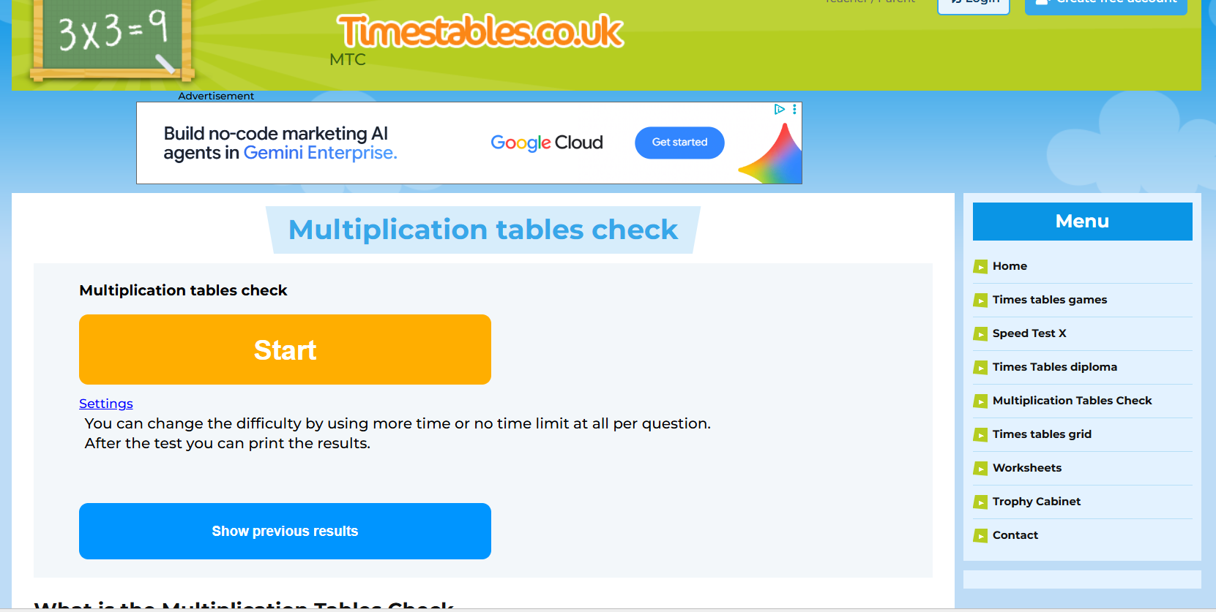
Multiplication Check Revision
In preparation for their test in June, all children will be expected to use the following website to practice their multiplications weekly.
This is alongside their 20 minutes of TTRS and will help massively in preparing them for their official test in Summer.
In class, we will carry out weekly assessments, booster sessions and continued support, praise and feedback to ensure your child is confident and prepared for their test.
https://www.timestables.co.uk/multiplication-tables-check/

Slide 12

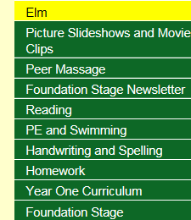
Newsletters and dates for your diary
School’s website http://www.manor-road.lancsngfl.ac.uk/ Keep an eye on dates and
Our newsletter is updated weekly and it provides you with lots of information and key dates to be aware of.
Please also use the website to view our class page.

Slide 13
General Notices
1. If anyone new/different is collecting from school, please inform the office either by telephoning, DOJOs or sending a note in.
2. Please can children have notes/letters/money in their hands as they come into school to ensure it goes straight in the box.
3. Children may bring in water in water bottles but they must go home every evening.
4. Children can bring in a healthy snack for break time.
5. Lunches are chosen.
6. The Home School Agreement will be sent home via a ParentMail form.
7. Please remember to follow the one-way system and speed limit so we can keep everyone safe!

Slide 14
How can you help your child at home?
Talk to your child about their book and try and listen to them read a couple of times a week.
If needed, support your child with work brought home and key words/common exception words/spellings.
Encourage your child to have a ‘can do’ approach and always encourage children to have a go!
Thank you for taking the time read this information.
Any questions, please message on DOJOs. ☺

