Slide 2
At Manor Road, we run the Maths No Problem! Scheme across Reception to Year 6.
The Maths No Problem! Scheme is sometimes known as ‘Singapore Maths’.
On the next few slides, you’ll see why at Manor Road, we switched to the Maths No Problem! way of teaching maths, following the success of the overhaul in education in Singapore.

Slide 5
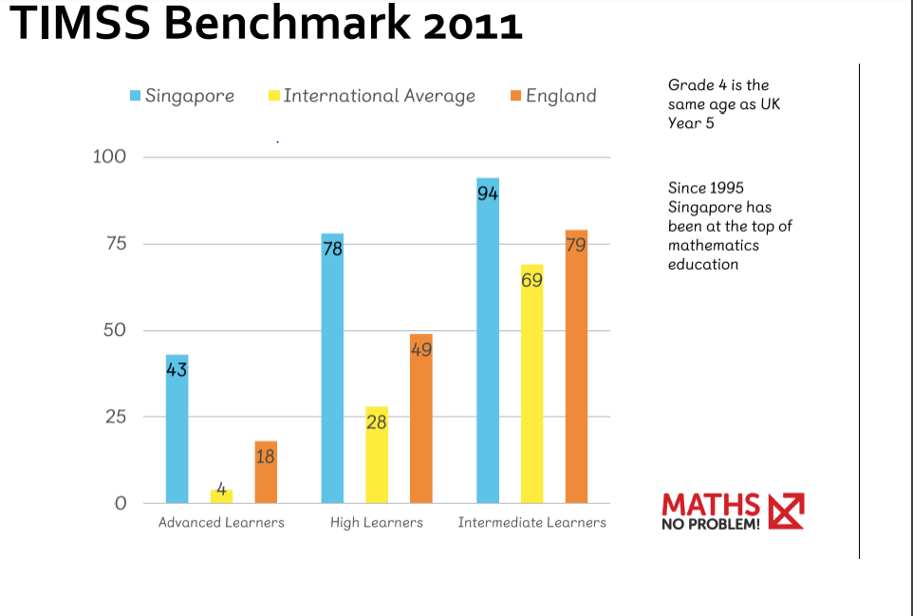

Slide 7
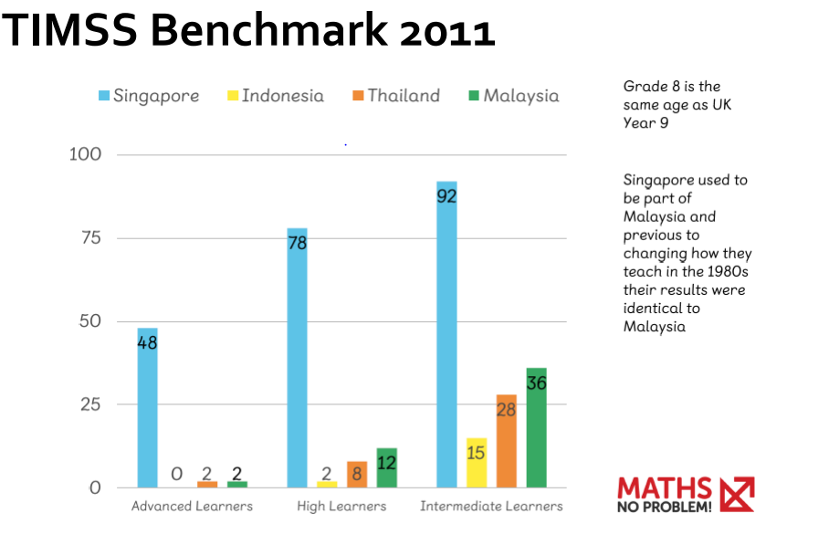

Slide 16
Every lesson in maths starts with a real life problem
We believe this is really important for children. It embeds the idea that maths is useful to our real lives and the methods we are confident with can be used across a wide range of mathematical contexts and scenarios.
Children ‘explore’ the problem together, discussing their methods and using concrete resources to help them.

Slide 19
After exploring the problem, the class are guided by the teacher to share useful methods. Children are encouraged to choose a method which works for them.

Slide 21
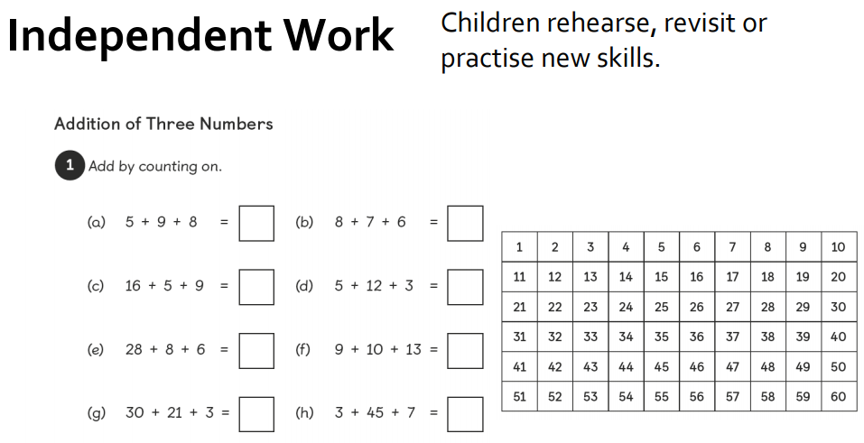

Slide 25
Some children receive support in their workbooks whilst others answer independently.
After independent work in workbooks, children have access to a number of challenges that they can work through.
They are also encouraged to self correct their work after it has been marked.

Slide 31
What can you do to help at home?
Be positive
Talk maths with your child
Involve children in any maths activity – shopping, cooking, DIY – let children lead where you can
Talk about maths within sports
Encourage quick recall of multiplication and division facts (children have log in details for Numbots and Times Tables Rockstars which are both great at rapid recall)
Look at number puzzles in papers or magazines
Don’t be afraid to share methods with your child. Yes, methods change over time and what you were taught at school may be different to how they are being taught now but don’t be afraid to share how you were taught. What’s changed? How has it changed? Is it still an accurate method?

Slide 32
Parent videos available from the Maths No Problem! website:
https://mathsnoproblem.com/en/parent-videos/
Maths section of the school website:
http://www.manor-road.lancsngfl.ac.uk/information/maths-2/
Useful websites from the maths section of the school website:
http://www.manor-road.lancsngfl.ac.uk/information/maths-useful-websites/
If you need any support or have any questions, you can contact your child’s class teacher or alternatively, contact Katy Elford (the maths coordinator) on: kelford@manorroad.lancs.sch.uk I am due to start maternity any week now so if your enquiry is not responded to, this will be the reason why. You could then contact your child’s class teacher.

